Slide 1
Database DevOps
Section 4

Slide 2
Best Practices for Development
Dark Launching
Adding objects to the database that aren’t used by the application
These changes don’t disturb the application

Slide 3
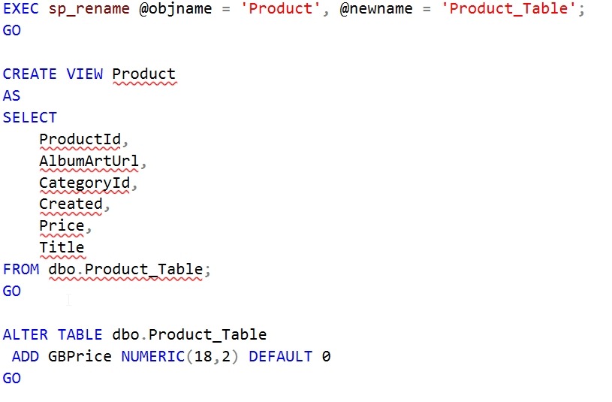
Dark Launching for tables

Slide 4
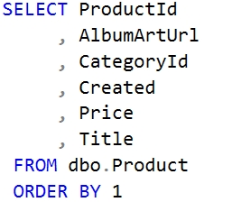
Best Practices for Development
Avoid depending on column order

Slide 5
Monitoring Your Release
Monitoring provides feedback (one of the three ways)
Gather metrics on
Resources
Business counters
Object usage (essentially feature usage)
Ensure deployment timestamps are captured in your monitoring tool
Be sure dark launches are really dark

Slide 6
Branching
Each branch needs its own database
Data is the problem
New columns – where do I get data?
No column – what do I do with the data?
Provisioning new databases becomes important
You can use the same branch strategy as application code
Keep these short lived.

Slide 7
Merging
Merging changes can be merging code and data (if tracked)
SQL requires manual merges, but use tools
Kdiff3
CodeCompare
Beyond Compare
Etc.
Merge as often as you can (as you would with C#)
Beware squashing and deleting branches.
Merging back to the branch from master is better

Slide 8
Provisioning Database Environments
Use Automation
All environments should be configured the same
Dev == QA == Staging == Production
Builds Confidence
Databases are cattle

Slide 9
Dealing with Disparate Environments
Two main issues
Version upgrades
Separate Databases
V1.0
V1.1
V2.0
V2.2
Customers
Orders
OrdersDetail
GetCustomers
GetaDailySales
SalesCommissions
Customers
Orders
OrdersDetail
GetCustomers
GetMonthlySales
RunCEOReport
Customer A
Customer B

Slide 10
Dealing with Disparate Environments
Alex Yates, DLM Consultants offers guidance
Part 1 – Managing objects for different versions - https://www.red-gate.com/blog/database-lifecycle-management/how-to-build-multiple-database-versions-from-the-same-source-using-sql-compare-filters
Part 2 – Post-deploy scripts - http://www.red-gate.com/blog/database-lifecycle-management/post-deploy-scripts
Part 3 – Pre-deploy migration scripts - http://www.red-gate.com/blog/database-lifecycle-management/pre-deploy-migration-scripts

Slide 11

Shared Lookup Data
Custom Objects
Shared Objects
Custom Lookup Data

